Slide 1
Cyber Safety in 2022
Jennifer Bayuk
www.bayuk.com
www.framecyber.com

Slide 2
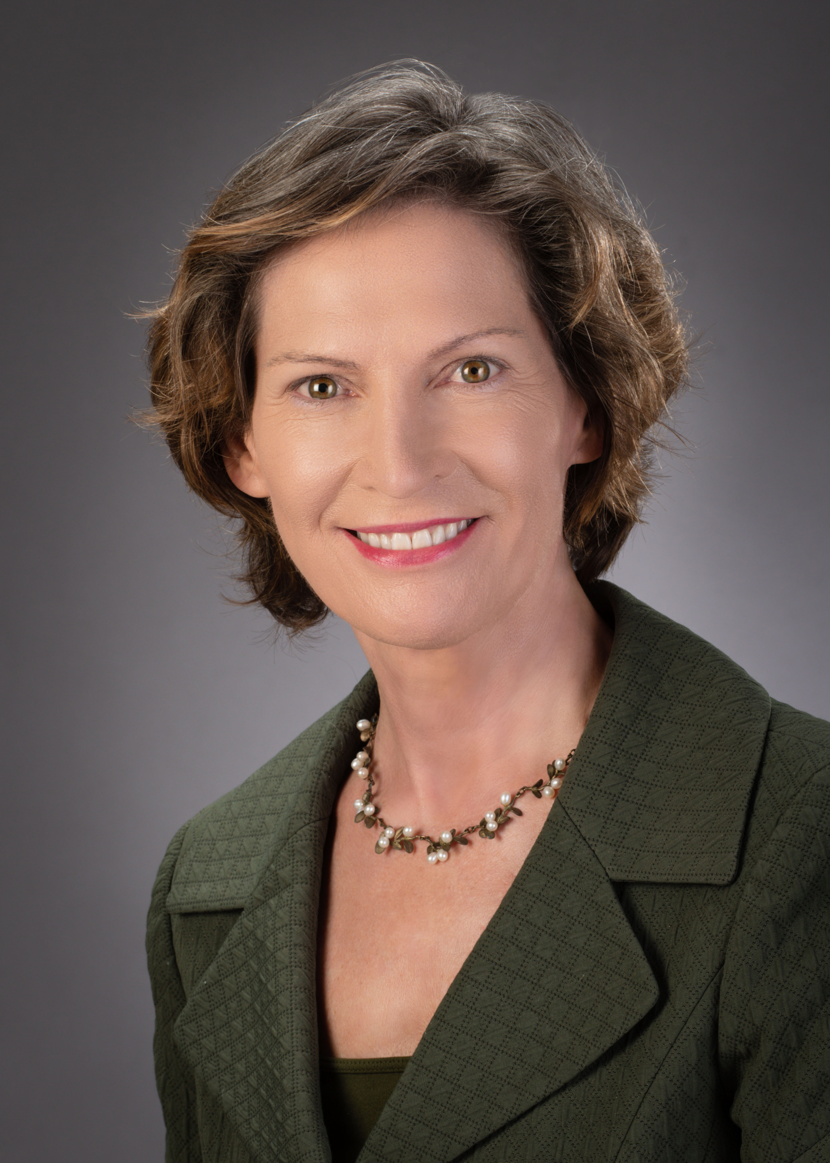
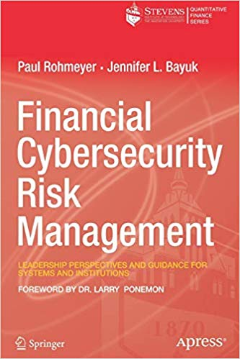
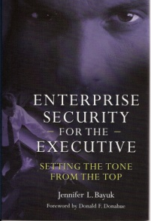
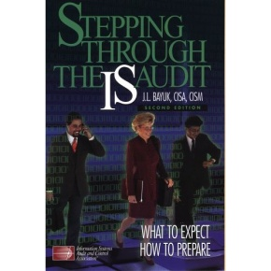
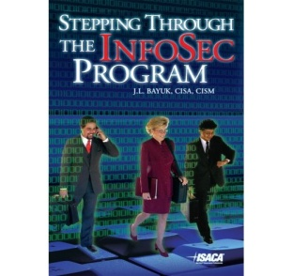
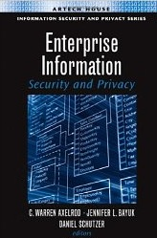
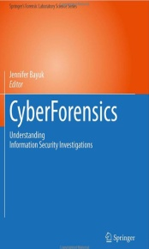
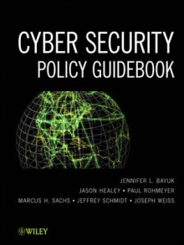
Professor Jennifer Bayuk, Ph.D.
Experienced in a wide variety of private security positions, including Wall Street Chief Information Security Officer, Financial Services Internal Audit, Global Bank Operational Risk Management, and Big 4 Information Systems Risk, CEO of Security Software Startup.
Created curriculum for numerous information security, cybersecurity, and technology risk topics for conferences, seminars, corporate training, and graduate-level academic programs
Frequent contributor to Cybersecurity Committees educational forums. Current TAG-Cyber Analyst and Consultant.
BS in Computer Science and Philosophy, MS in Computer Science, PhD in Systems Engineering. Adjunct Professor of Cybersecurity.
Author of multiple textbooks and articles on security management topics. Several expert witness engagements
Many publications available at: www.bayuk.com
Jennifer’s cybersecurity experience enables her to give practical advice to the home user of digital devices. No technical experience required. Her talk will cover:
Cybersecurity Threats
Home Cyber Hygiene
Cyber Security for Children

Slide 3
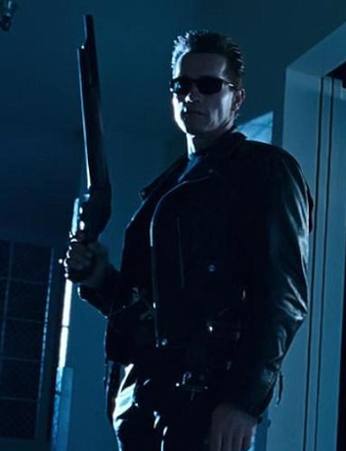
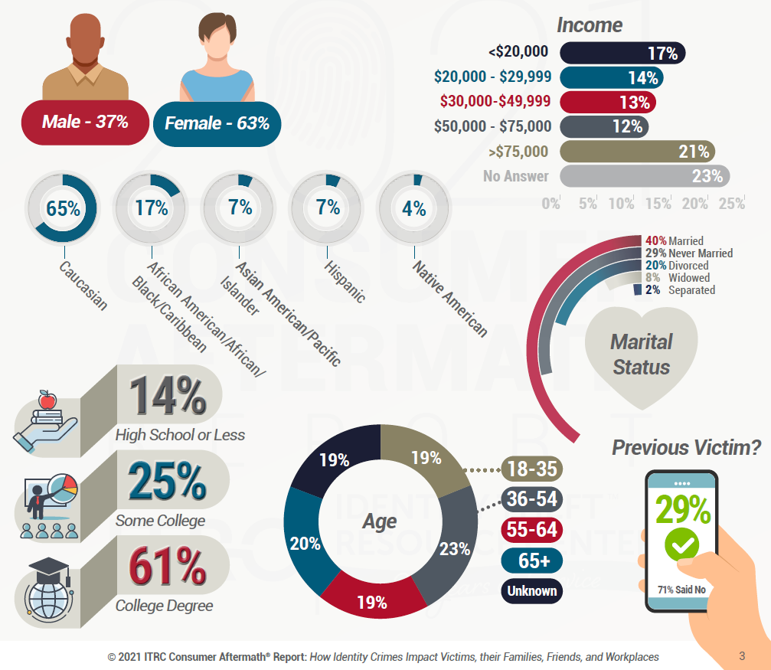
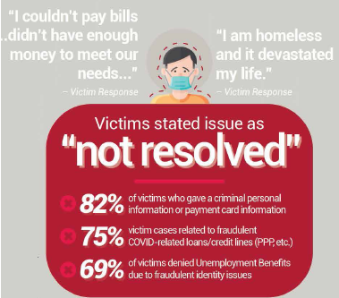
Cyber Threats
are dangerous adversaries
Identity
Theft
Survey
Results
Have you been compromised?
https://haveibeenpwned.com/

Slide 4
Access Control
https://www.my1login.com/mini-password-meter.html
https://www.uic.edu/apps/strong-password
Choose Strong Passwords
For accounts at banks and wherever money changes hands, use different passwords for each site and choose passwords based on phrases that
  (i) remind you of the account, and
  (ii) make you smile
I like to shop for clothes at Talbot’s
!|2$h0p4(@T’5
For unimportant accounts, it is ok to have a repeatable pattern, but still make them unique in some way to thwart automated account-takeover, for example, for your newspaper and recipe-sharing site:
Reading news can be a challenge.
RN(8@chall.
Reading recipes can be fun.
RR(8f0n.
Use Multi-Factor authentication on all accounts where it is available.

Slide 5
Control Your Financial Identity
Identity thieves often file false tax returns, steal social security checks, and apply for credit in the victim’s name. Take ownership of these online accounts so they are not available for exploit.
Register with IRS for a PIN: https://www.irs.gov/individuals/get-an-identity-protection-pin
Register with Social Security: https://www.ssa.gov/myaccount/
Freeze your credit reports when you are not using them. This hold can be temporary or permanent and in either case can be under your control. Lenders use these three services to check a credit rating for someone applying for credit:
  Equifax – www.eqifax.com
  Experian – www.experian.com
  TransUnion – www.transunion.com
  Create an account on all three, then set up a credit hold or freeze. Thereafter you can temporarily lift it if you have applied for credit, and put it back after the lender’s credit check is complete. Ask the lender which credit company will be used to check your credit and temporarily lift the hold with only that company.
Avoid peer-to-peer money transfer applications like Venmo and Zelle, fraudsters who find out to whom you may transfer funds often register in deceptive ways and there is no refund when you send money to the wrong person. These services will simply tell you that you authorized the transaction.

Slide 6
Protect Your Phone
Simplify your phone experience. Delete all the applications on your phone that you do not use. Hesitate to add new ones, find some independent research to read before taking advice from a friend.
Activate Find My Phone Features:
  - Apple: http://www.apple.com/icloud/find-my-iphone.html
  - Other models, google “Find my phone” to find the service
Find the “Location Services” setting on your phone and turn off all services except Find my iPhone and Maps.
Deactivate geolocation features from photos as they can be used to track your location as well.
Be on the lookout for friendly or too-good-to-be-true spam text from strangers. On iPhone, turn on the setting: “filter unknown senders” on other phone, consider “block unknown senders.” Carefully erase those texts without clicking on them.
Write down your phone serial number and model number in case it gets stolen (find in settings).
If you lose your phone:
  - Use your Find my Phone feature. If you cannot locate it, call it while it still has battery to see if a friendly person will send it back
  - If not, call your service provider and turn off the service and have it wiped, change all your passwords, and report it to the police.
  - Whether not you get it back, change all your passwords. If you do get it back, back it up then wipe it before changing your passwords, and if possible, change the password on your computer, not on your phone

Slide 7
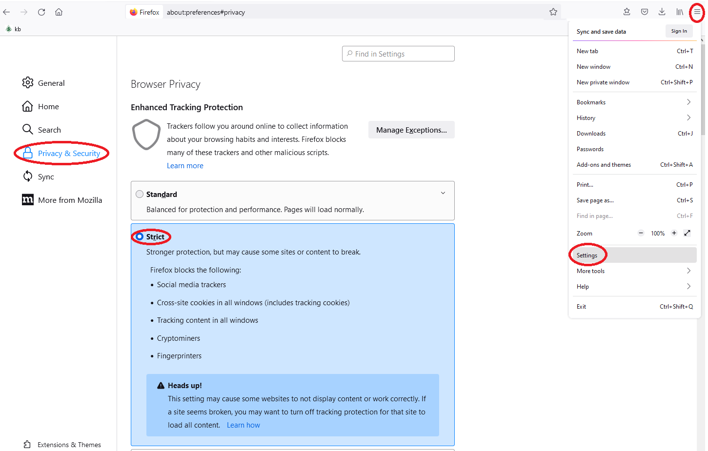
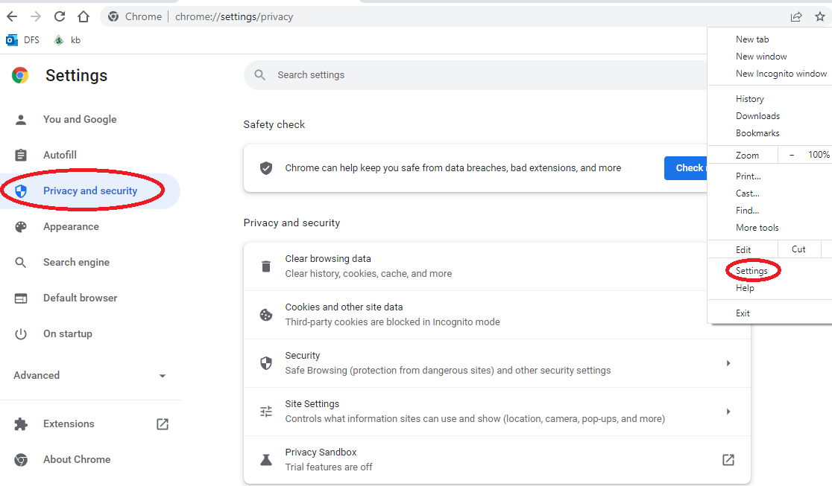
Firefox
Other Personal Cybersecurity Hygiene
Remove all programs you don’t use from start.
Install and enable the (Software) auto-update features in your Operating System (OS) (Mac – Windows)
Enable all of your computer’s Operating System Security Features
Consider password protecting files that include personal or financial information using simple solutions like winzip.
Password protect your wireless network with a strong password.
Away from home, avoid guest wireless networks, travel with a wireless hotspot directly connected to a phone company if you need to be online. You can also let your guests use it instead of your home wifi.
Record all device serial and model numbers.
Set all of your browser’s security features to the highest setting.
Chrome

Slide 8
Ransomware
Become familiar with it before strikes:
  https://www.avast.com/en-us/ransomware-decryption-tools
According to the Department of Homeland Security, 90% of successful cyberattacks start with someone clicking on an email.
  Don’t click on links unless you know exactly who they came from and why they were sent.
  If you are not 100% sure, call or text the person who sent them before opening. If you cannot contact them, just wait.
  If you decide an email is suspicious, delete it without opening it.
Keep a backup in a cloud service, a fireproof safe, or both.
Avoid dependency on a single vendor like Microsoft or Apple, consider putting your cloud backup in a storage service like Dropbox or AWS Buckets as a diversity tactic.

Slide 9
Protect your Children’s Identity
All of the preceding material applies to children as well.*
Many young people only find out when they apply for their first credit card or student loan that their identity has been in use piling up bills for years and the situation is very difficult for a young person to resolve.
https://www.consumer.ftc.gov/articles/0040-child-identity-theft
That said, additional precautions are required to keep children safe online.
    https://www.fbi.gov/news/stories/cyber-alerts-for-parents--kids
    https://www.fbi.gov/news/stories/fbi-releases-new-version-of-child-id-app
    Or search “FBI Child ID” in iPhone AppStore or Google Play, the app provides parents with an easy way to electronically store the children’s pictures and vital information that police will need in case a child is missing.
*Except maybe the IRS….

Slide 10
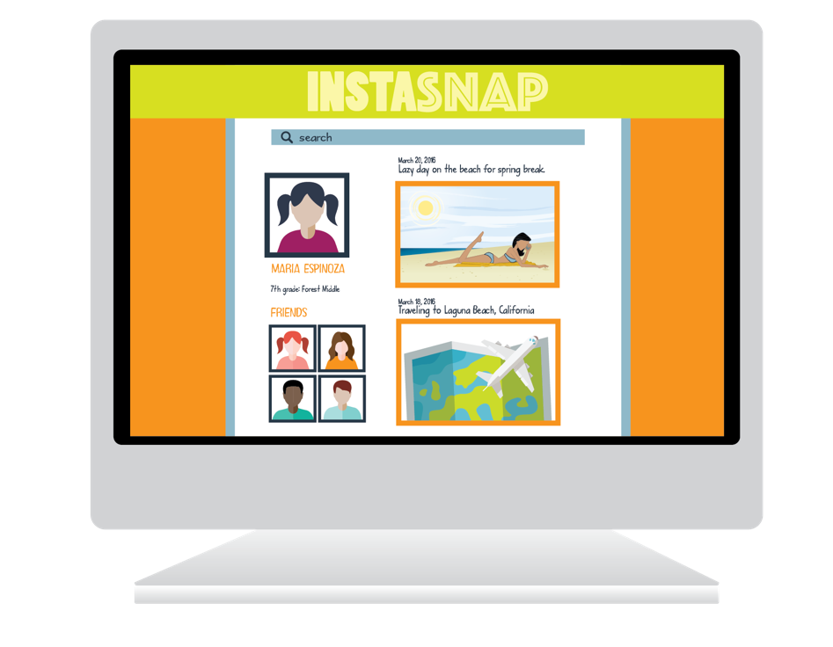
LET YOUR KIDS KNOW:
Kids need to understand that anything they share online could stay online FOREVER.
Online activity and posts could be available to everyone including future employers and colleges.
Social media should not become a popularity contest.
Treat others the way we want to be treated.

Slide 11
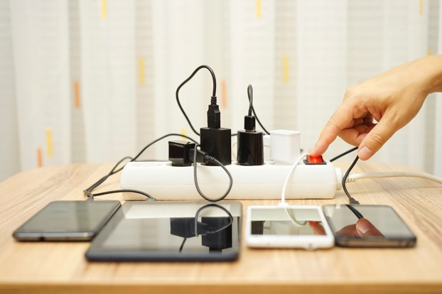
SET UP SIMPLE ACCESS CONTROLS
Regulate usage times—especially at night.
Prevent usage in private.
If there must be a computer in a bedroom, make sure the screen faces the door.
Keep devices in a central location.
Set up central charging stations to keep all devices together.
Many devices can be set up so a child’s account cannot be used to download or install apps without parental consent.
Always set up device controls before giving it to your child.

Slide 12
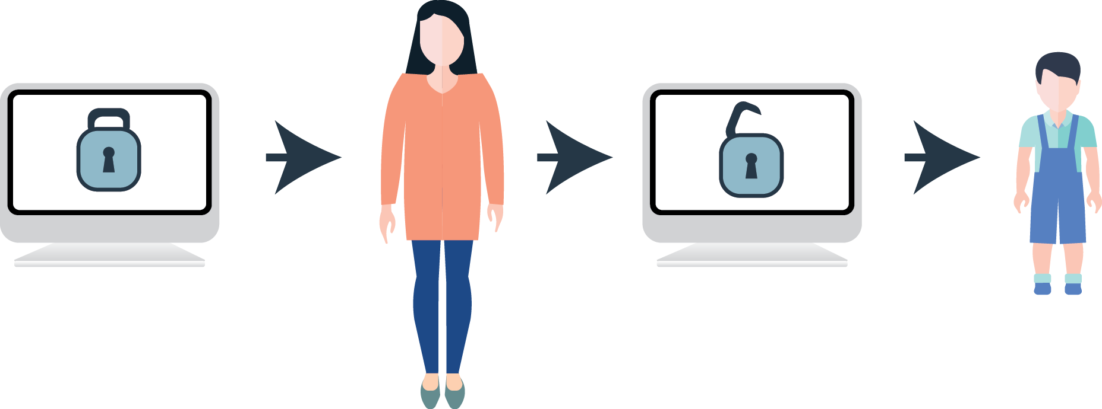
FOR EVEN GREATER CONTROL:
Create all of your child’s online passwords for them and
require the child to have you input them before use of
online accounts or purchasing apps.
Ensure your child’s profile is set to Private. Go into settings and adjust the default controls.
Explain that what is posted on the internet is impossible to remove.
“Friend” or “Follow” your kids so you can check in on their social media activity.
Make parental approval of social groups or networks part of a child-parent Internet Contract.

Slide 13
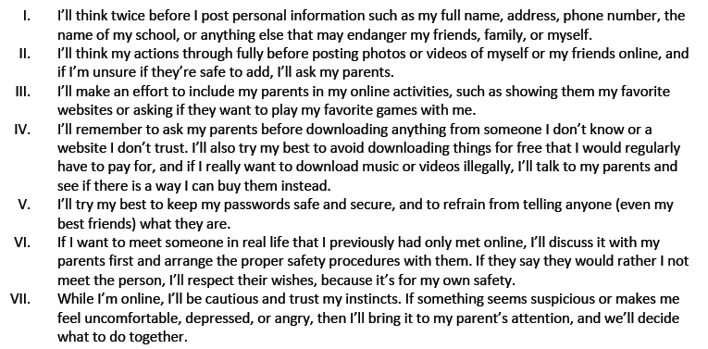
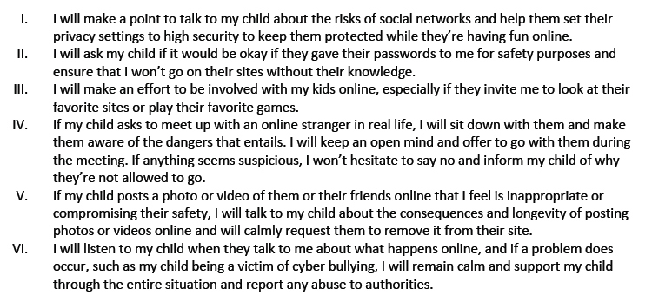
Example Child-Parent Internet Contract
CHILD RESPONSIBILITIES:
PARENT RESPONSIBILITIES:
CHILD SIGNATURE:
PARENT SIGNATURE :

Slide 14
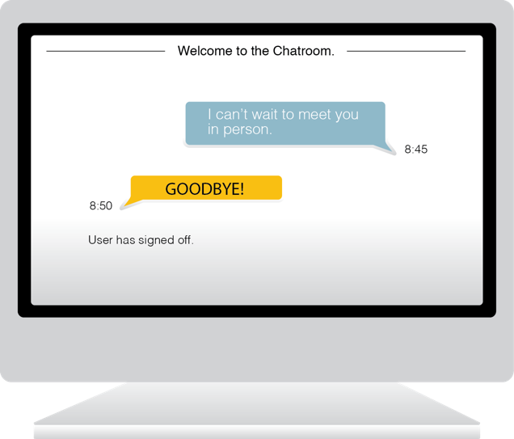

CHATROOMS and SEXTING
Talk to your children about taking and sharing sexually explicit photos.
If your children visit chat rooms, they should:
Remain anonymous.
Choose an alias that does not give away their name or location.
Sign out if the topic turns to a sensitive issue like sex and drugs.
Never follow a stranger’s instructions, send photos or download content.
Never agree to meet a stranger they met online.
Using a picture messaging app does not mean the photo will really disappear within seconds.
Take a screen shot with your phone of a picture message so your child can see: nothing is truly secret or deleted once it is sent.

Slide 15
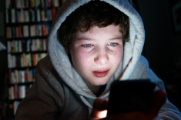
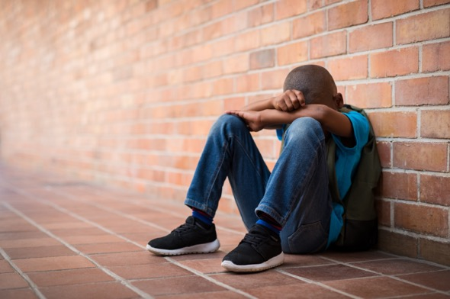
CYBERBULLYING
WATCH FOR THE FOLLOWING SIGNS THAT YOUR CHILD MAY BE THE VICTIM OF CYBERBULLYING:
Anger, depression, or frustration after using any devices.
Stops using devices unexpectedly.
Stops accessing social media sites, apps, or games.
Uneasy about going to school.
Abnormally withdrawn from usual friends and family members.
Cyberbullying can happen anywhere hurtful or offensive comments or photos can be sent or posted.

Slide 16
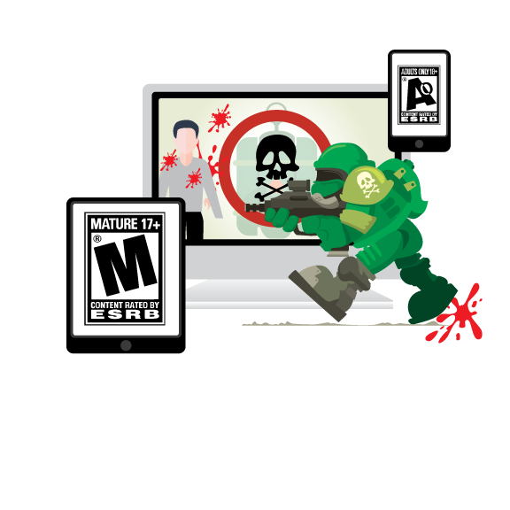
THIS IS GAMING
Games can include violence, murder, nudity, and prostitution.
And now they are online with strangers.
Talk to your kids about desensitization to violence and the negative impact it has on human lives.

Slide 17

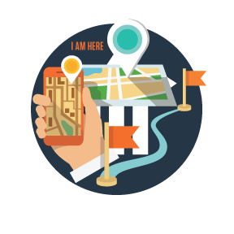
A PICTURE CAN BE WORTH MORE THAN YOU KNOW
Never share your age, school, address, phone number, last name, vacation information, or when parents are not home.
Posted photos can also reveal too many details, do not post photos that include your school, address, phone number, last name, vacation information, or when parents are not home.
Do not post pictures while still on vacation.
Criminals can use photo geotagging to find you.

Slide 18
Further Reading:
Cyber-Based Physical Crime: Future Crimes: Inside the Digital Underground and the Battle for Our Connected World (2016) by Mark Goodman. An ex-cop describes how murderers and thieves use the Internet to hunt and surveil targets.
Cyber Crime: Fatal System Error: The Hunt for the New Crime Lords Who Are Bringing Down the Internet (2010) Joseph Menn. A story of a cybersecurity entrepreneur stumbling into organized cybercrime and becoming a target.
Cyber War: This Is How They Tell Me the World Ends: The Cyberweapons Arms Race (2021) by Nicole Perlroth. A reporter’s account of nation-states pursuit of superior offensive capability.
Espionage/Suspense: The Cuckoo's Egg: Tracking a Spy Through the Maze of Computer Espionage (1989) by Clifford Stoll. A suspenseful narrative of the hunt for a nation-state hacker.
Science Fiction: Ghost Fleet: A Novel of the Next World War (2015) by P. W. Singer and August Cole. A scenario in which nation-state adversaries launch a sophisticated cyberattack against the United States.
Technology: Cyber Attacks: Protecting National Infrastructure (2012) by Ed Amoroso. Describes cyber defense technology in terms accessible to a laymen.

Slide 19
Thank you!
Jennifer Bayuk
jennifer@bayuk.com
www.bayuk.com
www.framecyber.com

